Slide 1

your digital future
Kathy Reid BA/BSc, MBA (Computing)
Independent Digital Technical Consultant
Director of Developer Relations, Mycroft.AI, President, Linux Australia
@KathyReid on Twitter, GitHub, LinkedIn etc.
Notes:
Thanks so much ANABEL
Hi everyone. Firstly, I’d like to congratulate everyone tonight for choosing to be a part of the Girls Leading Advanced Manufacturing and Geelong Future Leaders in Industry programmes. Advanced manufacturing, 3D printing, additive manufacturing, robotics and automation will play a huge role in the future of our society, and you’ve already taken a huge step forward in gaining exposure to these areas.
When I asked Anabel what I should talk about tonight, she gave me some very simple instructions – or what appeared to be simple instructions.
INSPIRE YOU

Slide 2
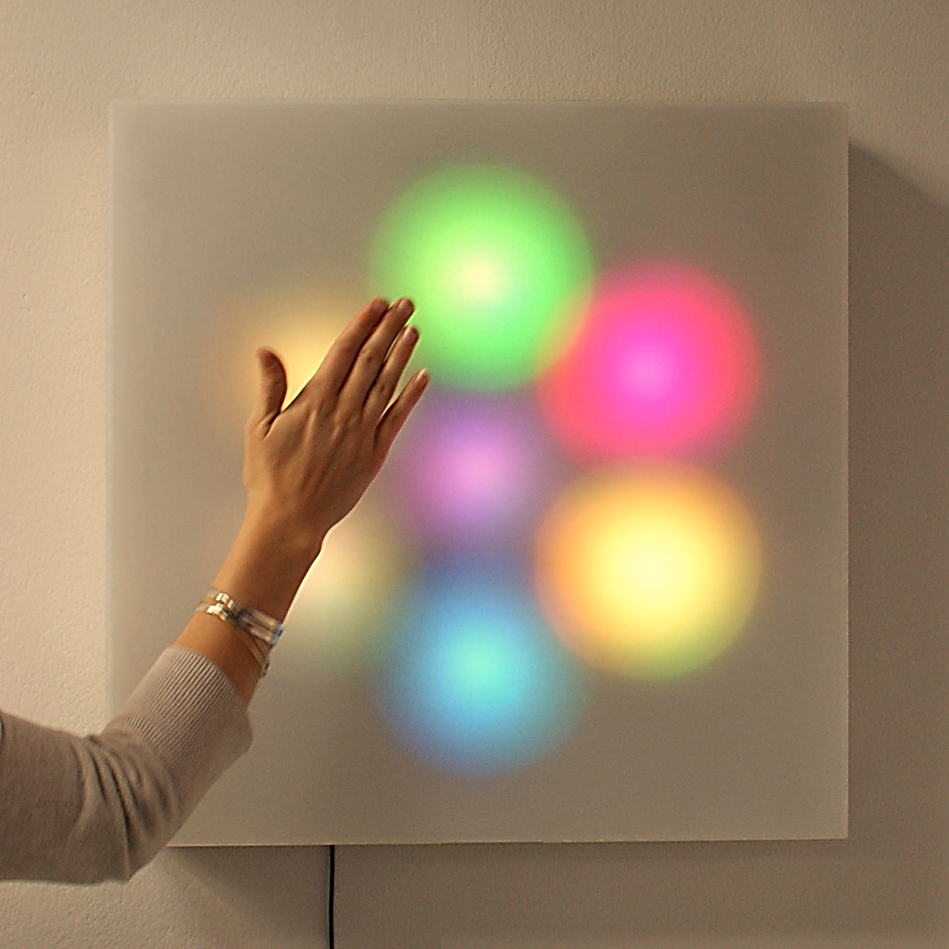

Inspire you
Background image: 5ml: Mimetics by Design Initiative
Credit: https://flic.kr/p/akFu8M
Easy, right?
Notes:
So, inspiring you would be easy, right?
So firstly, how many of you would like to earn lots of money?

Slide 3
        Money
Notes:
There’s the money angle. dollars, pounds, bitcoin – whatever currency we have in the future?
Great – engineering salaries are consistently some of the highest professional salaries.

Slide 4
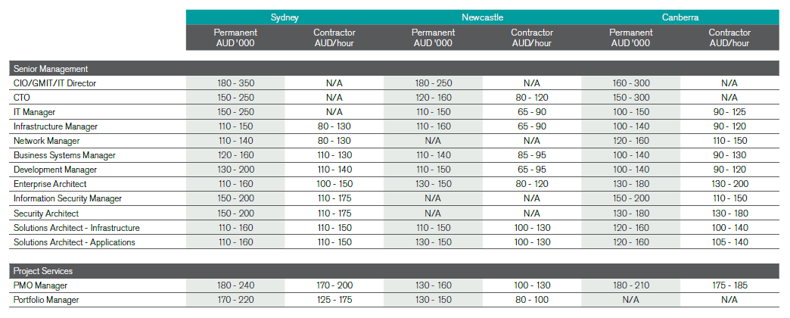
        Money
Notes:
And IT salaries are pretty good too

Slide 5
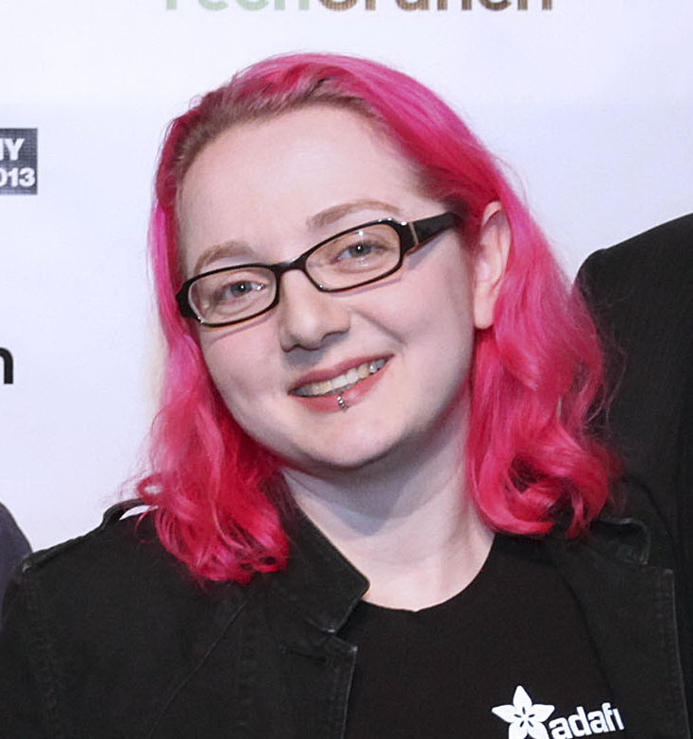
Igniting our desire to make, create and explore
As electronics and the Internet of Things becomes easier, companies are supporting our desire to ‘make’
Limor ‘LadyAda’ Fried
Electrical Engineer and Founder of AdaFruit Electronics
Background image: Limor Fried at TechCrunch Disrupt NY 2013 (cropped) Photo by Max Morse https://commons.wikimedia.org/wiki/File:Limor_Fried_TC2013.jpg
Notes:
But it’s not just about money.
What if you could turn something you love doing into your career?
The internet of things and the rise of hobbyist electronics is also sparking – forgive the pun – other movements – the Maker Movement, and we’re seeing the rise of services catering to this movement.
This is Lady Ada – Limo Fried – and in 2005 she founded AdaFruit, and electronics company, that this week bought out RadioShack, one of the largest electronics companies in America. Oh, she has a Masters in Electrical Engineering, too ☺ She turned her hobby, her passion, into a lucrative career.

Slide 6
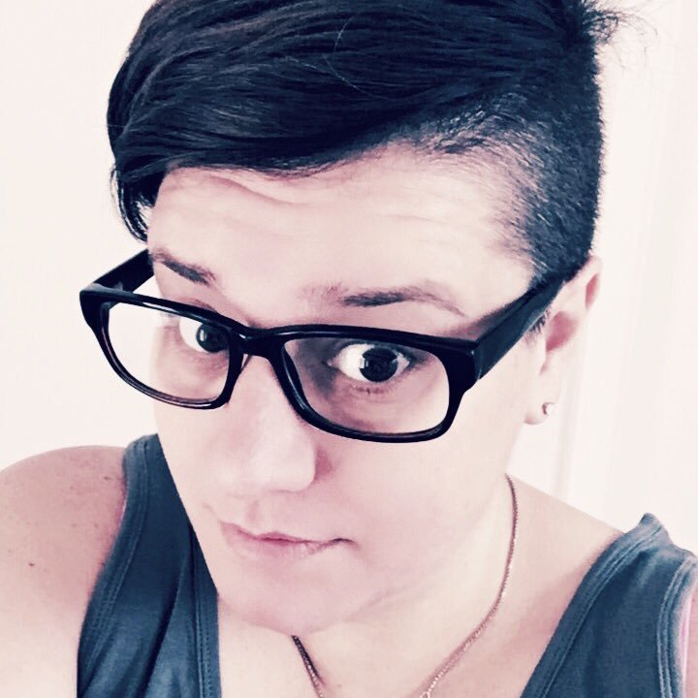
Helping people
As the average age of Australian first time Mums edges over 30, many couples need assistance in fertility and conception
Dr Hannah Brown, Postdoctoral Fellow, University of Adelaide
Reproductive science, IVF and fertility scientist
Notes:
Different people are inspired by different things.
Who here would really like to help others with your career?
This is Hannah Brown – she’s a reproductive scientist in Adelaide, and she works with technology that helps couples to have babies.

Slide 7
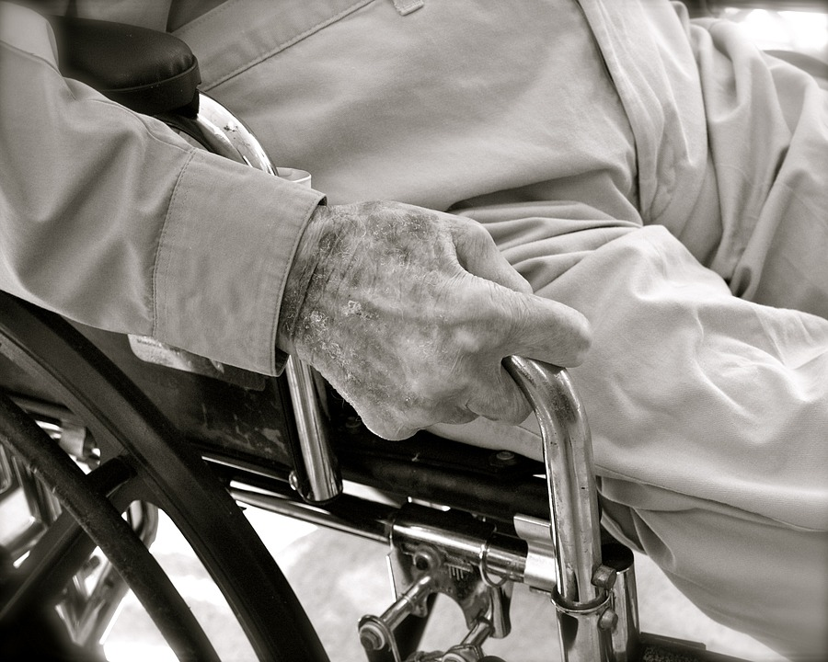
Helping people
Background image: Maxpixel http://maxpixel.freegreatpicture.com/static/photo/1x/Senior-Aging-Elderly-Aged-Mature-Person-2379003.jpg
Over the past two decades, the number of persons aged 85 years and over increased by 141.2%, compared with a total population growth of 32.4 over the same period
Source: Australian Bureau of Statistics
Notes:
We’re also seeing the rise of technologies like the internet of things to assist our growing elderly population, providing benefits like the ability to stay independent for longer. Over the next 20 to 30 years – the time span in which you’ll live your working lives – our elderly population is set to triple. Manufacturing, engineering and technology advancements will help us provide better care to more Senior Australians.

Slide 8
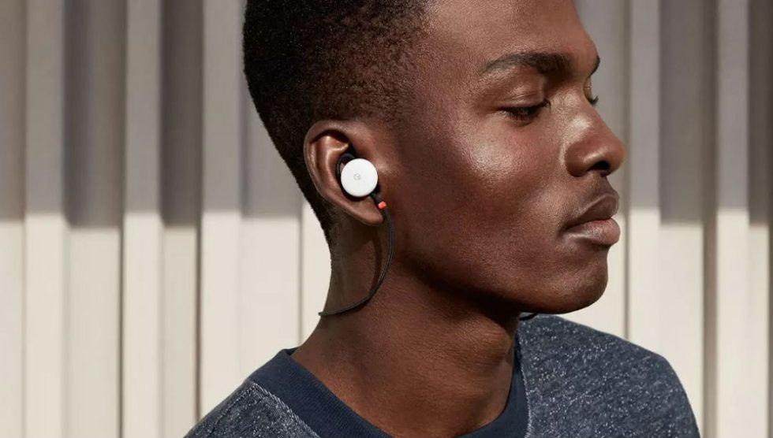
Connecting the world – breaking down barriers
Notes:
Technical advancements are also helping us connect with each other – not just across distances with technologies like video conferencing, but across language and cultural divides. This device is Google’s Pixel Ear buds, and they translate spoken language in real time. So you can be speaking Swahili, or Urdu, or Tieng Viet – to someone across the world.

Slide 9

Notes:
On a similar note, this is Mozilla’s Common Voice project. They’re capturing voice samples from people all over the world – every language, every accent, every dialect – to make an open source collection

Slide 10
You can change the world.
Notes:
So yes, with a career in STEM – engineering, science, maths, technology – you have the ability to earn a lot of money, have great business opportunities, the ability to help others, break down barriers between cultures. But there’s one other piece here, and it’s the most important.
You have the ability to change the world.
Don’t believe me?

Slide 11
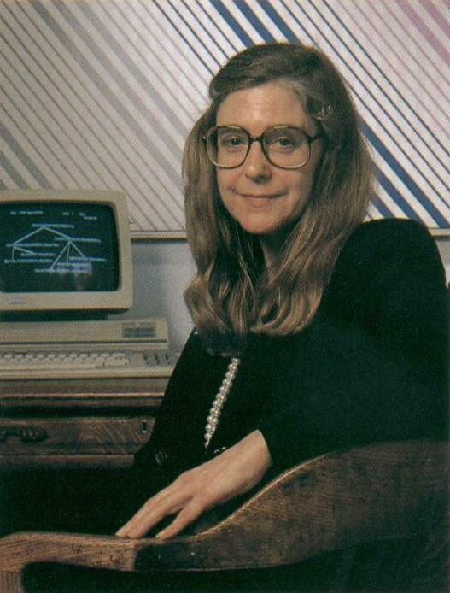
Margaret Hamilton
Computer scientist, NASA.
Wrote the code that put humans on the moon.
Notes:
This is Margaret Hamilton. She wrote the code for the Apollo space missions.
No biggie ☺

Slide 12
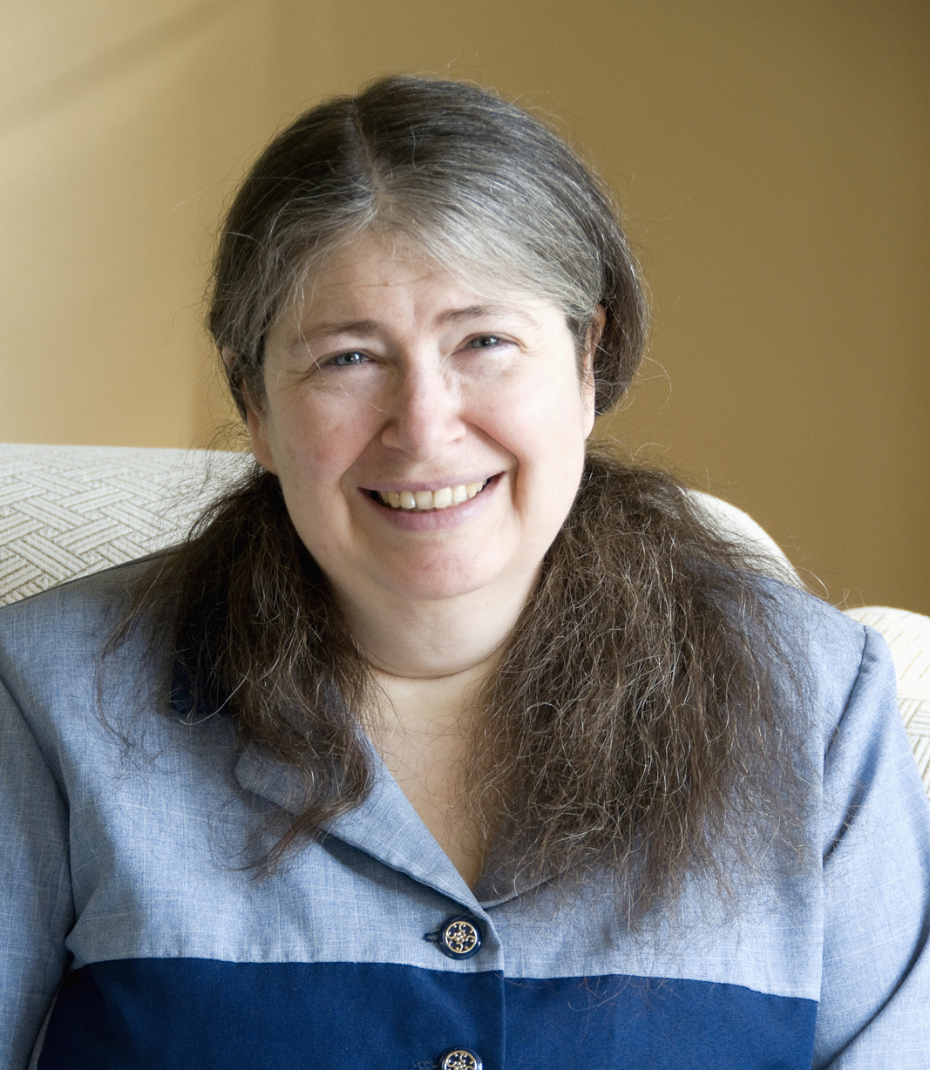
Radia Perlman
Computer scientist, Dell. “The mother of the internet”
Wrote something called Spanning Tree Protocol. It sounds mundane. It’s not.
Notes:
This is Radia Perlman. She’s a computer scientist. She wrote something called Spanning Tree Protocol. Every time you use the internet. Every time you log in to Facebook, send a Snap, your data follows paths determined by Spanning Tree Protocol. Without it, you wouldn’t have the internet.

Slide 13
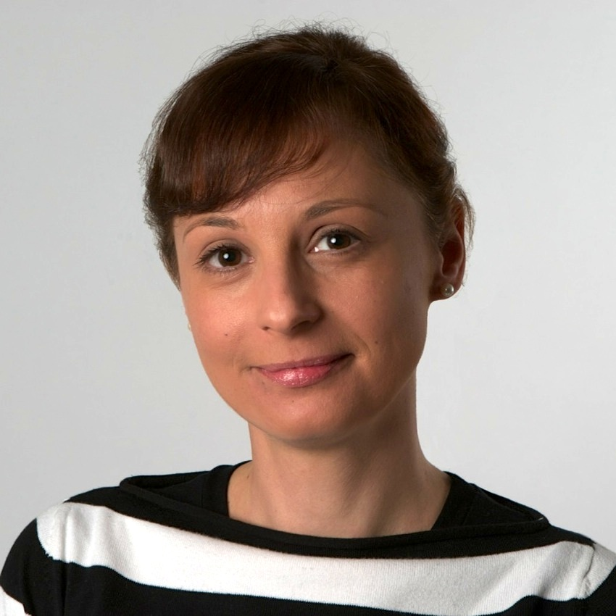
Catarina Mota
Founder of the Open Building Institute and OpenMaterials.org
Open source architecture – buildings for everyone
Notes:
This is Catarina Mota. She’s a materials engineer and is a specialist in smart materials. She’s building the houses of the future, that have not only automation built in, but are built in such a way that they’re modular, easily expanded and can can be built using sustainable, available materials.

Slide 14
Yes, really.
Notes:
All of these women are changing the world with their STEM skills – changing the world, and humanity, for the better.
And it was at this point that I realised I was asking the wrong question all the way throughout this presentation. The question I was asking was
“How will I inspire you”
When really the question I should have been asking was
“How will you inspire me?”
“How will you change the world?”

Slide 15
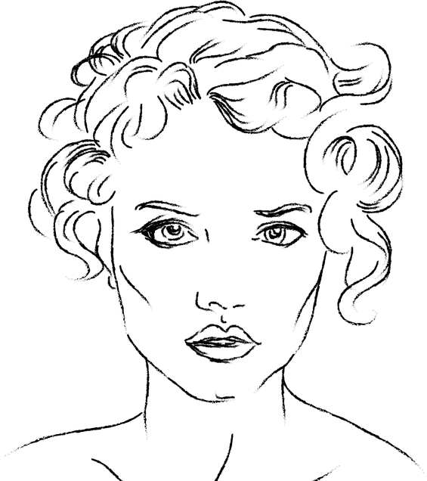
You
Nanotechnologist.
Quantum mechanist.
Machine ethicist.
Artificial intelligence engineer.
Astrophysicist.
Computational biologist.
Bioinformatician.
Advanced materials engineer.
Notes:
Best wishes on your STEM journey. Thank you.

